Slide 1
CONSTRUCTORS
TYPES OF CONSTRUCTORS

Slide 2
CONSTRUCTORS
A constructor is a special member function whose task is to initialize the data members of an objects of its class.
It is special because it has same name as its class name.
It invokes automatically whenever a new object of its associated class is created.
It is called constructor because it constructs the initial values of data members and build your programmatic object.

Slide 3
CONSTRUCTORS
It is very common for some part of an object to require initialization before it can be used.
Suppose you are working on 100's of objects and the default value of a particular data member is needed to be zero.
Initializing all objects manually will be very tedious job.
Instead, you can define a constructor function which initializes that data member to zero. Then all you have to do is declare object and constructor will initialize object automatically

Slide 4
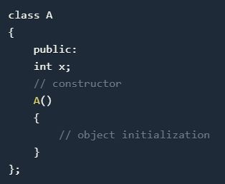
CONSTRUCTORS
While defining a constructor you must remember that the name of constructor will be same as the name of the class, and constructors will never have a return type.

Slide 5
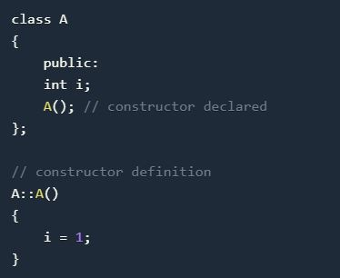
CONSTRUCTORS
Constructors can be defined either inside the class definition or outside class definition using class name and scope resolution :: operator.

Slide 6
CONSTRUCTOR CHARACTERS
They must be declared in the public scope.
They are invoked automatically when the objects are created.
They do not have return types, not even void and they cannot return values.
They cannot be inherited, though a derived class can call the base class constructor.
Like other C++ functions, Constructors can have default arguments.

Slide 7
CONSTRUCTOR CHARACTERS
Constructors cannot be virtual.
We can not refer to their addresses.
An object with a constructor (or destructor) can not be used as a member of a union.
They make ‘implicit calls’ to the operators new and delete when memory allocation is required.

Slide 8
CONSTRUCTOR TYPES
Constructors are of three types:
Default Constructor
Parameterized Constructor
Copy Constructor

Slide 9
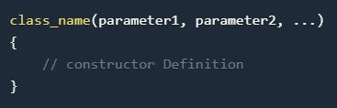
DEFAULT CONSTRUCTOR
Default constructor is the constructor which doesn't take any argument. It has no parameter.
Syntax :

Slide 10
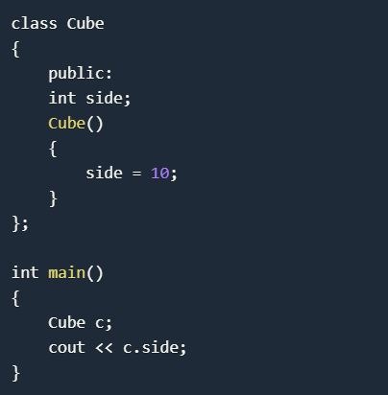
DEFAULT CONSTRUCTOR
Example
Output : 10

Slide 11
DEFAULT CONSTRUCTOR
As soon as the object is created the constructor is called which initializes its data members.
A default constructor is so important for initialization of object members, that even if we do not define a constructor explicitly, the compiler will provide a default constructor implicitly.

Slide 12
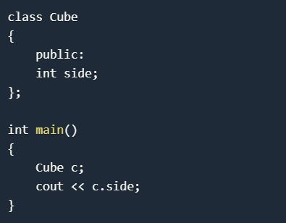
DEFAULT CONSTRUCTOR
Output: 0 or any random value
In this case, default constructor provided by the compiler will be called which will initialize the object data members to default value, that will be 0 or any random integer value in this case.

Slide 13
PARAMETERIZED CONSTRUCTOR
These are the constructors with parameter.
Using this Constructor you can provide different values to data members of different objects, by passing the appropriate values as argument.

Slide 14
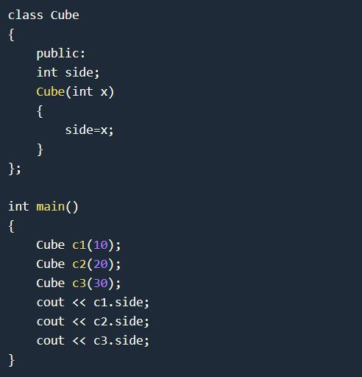
PARAMETERIZED CONSTRUCTOR
OUTPUT
10
20
30

Slide 15
PARAMETERIZED CONSTRUCTOR
By using parameterized constructor in above case, we have initialized 3 objects with user defined values. We can have any number of parameters in a constructor.

Slide 16
COPY CONSTRUCTOR
These are special type of Constructors which takes an object as argument, and is used to copy values of data members of one object into other object.

Slide 17
COPY CONSTRUCTOR
These are special type of Constructors which takes an object as argument, and is used to copy values of data members of one object into other object.
It is usually of the form X (X&), where X is the class name. The compiler provides a default Copy Constructor to all the classes.

Slide 18
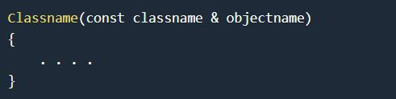
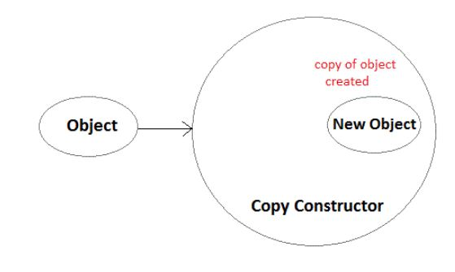
COPY CONSTRUCTOR
As it is used to create an object, hence it is called a constructor. And, it creates a new object, which is exact copy of the existing copy, hence it is called copy constructor.

Slide 19
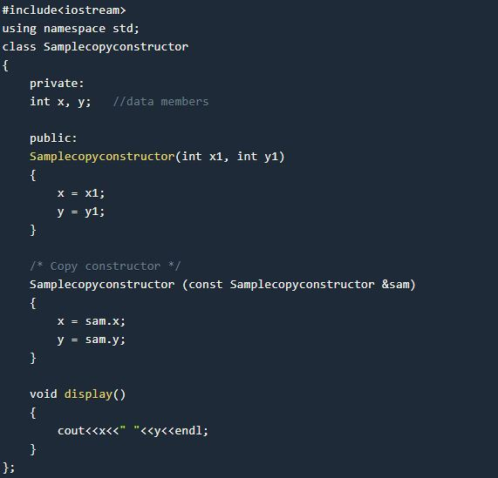
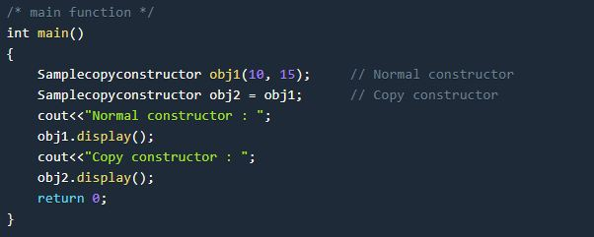
COPY CONSTRUCTOR

Slide 20
COPY CONSTRUCTOR
Output :
Normal constructor : 10 15
Copy constructor : 10 15

Slide 21
STATIC CONSTRUCTOR
C++ doesn’t have static constructors but you can emulate them using a static instance of a nested class.
class has_static_constructor {
friend class constructor;
struct constructor {
constructor() { /* do some constructing here … */ }
};
static constructor cons;
};
// C++ needs to define static members externally.
has_static_constructor::constructor has_static_constructor::cons;

Slide 22
FUNCTION OVERLOADING
Polymorphism
The word polymorphism is derived from Greek word Poly which means many and morphos which means forms.
Polymorphism can be defined as the ability to use the same name for two or more related but technically different tasks.
Eg-woman plays role of daughter,sister,wife,mother etc.

Slide 23
Overloading in C++
What is overloading
– Overloading means assigning multiple meanings to a function name or operator symbol
– It allows multiple definitions of a function with the same name, but different signatures.
C++ supports
– Function overloading
– Operator overloading

Slide 24
Why is Overloading Useful?
Function overloading allows functions that conceptually perform the same task on objects of different types to be given the same name.
Operator overloading provides a convenient notation for manipulating user-defined objects with conventional operators.

Slide 25
Function Overloading
Is the process of using the same name for two or more functions
Requires each redefinition of a function to use a different function signature that is:
different types of parameters,
or sequence of parameters,
or number of parameters
Is used so that a programmer does not have to remember multiple function names

Slide 26
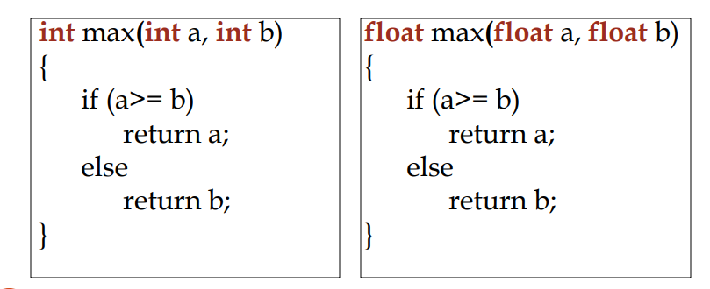
Function Overloading
Two or more functions can have the same name but different parameters Example:

Slide 27
Function Selection Involves following Steps.
Compiler first tries to find the Exact match in which the type of argument are the same,and uses that func.
If an exact match is not found,the compiler user the integral promotions to the actual argument such as,char to int, float to double.
When either of them fails ,build in conversions are used(implicit conversion) to the actual arguments and then uses the function whose match is unique. But if there are multiple matches, then compiler will generate an error message.

Slide 28
For ex: long square(long n)
long square(double x)
Now a func. call such as square(10) will cause an error because int argument can be converted into long also and double also.so it will show ambiguity.
User defined conversion are followed if all the conversion are failed

Slide 29
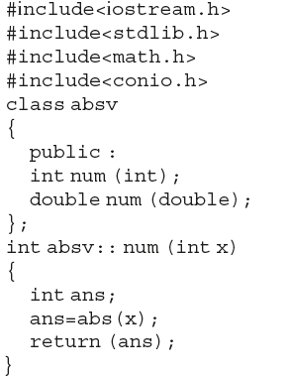
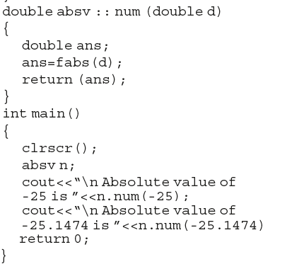
Overload Member function

Slide 30
Example
#include <iostream>
using namespace std;
class Addition {
public:
int sum(int num1,int num2) {
return num1+num2;
}
int sum(int num1,int num2, int num3) {
return num1+num2+num3;
}
};
int main(void) {
Addition obj;
cout<<obj.sum(20, 15)<<endl;
cout<<obj.sum(81, 100, 10);
return 0;
}

Slide 31
Operator Overloading
Operator overloading
Enabling C++’s operators to work with class objects
Using traditional operators with user-defined objects
Requires great care; when overloading is misused, program difficult to understand

Slide 32
Operator Overloading
Examples of already overloaded operators
Operator << is both the stream-insertion operator and the bitwise left-shift operator
+ and -, perform arithmetic on multiple types
Compiler generates the appropriate code based on the manner in which the operator is used

Slide 33
General Rules for Operator Overloading
Overloading an operator - Write function definition as normal
Syntax:
returnType classname::operator op(arguments)
{
Function body;
} Function name is keyword operator followed by the symbol for the operator being overloaded

Slide 34
General Rules for Operator Overloading
Using operators
To use an operator on a class object it must be overloaded unless the assignment operator(=)or the address operator(&)
Assignment operator by default performs memberwise assignment
Address operator (&) by default returns the address of an object

Slide 35
Steps
1. Create a class that is to be used
2.Declare the operator function in the public part of the class. It may be either member function or friend function.
3.Define operator function to implement the operation required
4.Overloaded can be invoked using the syntax such as: op x;

Slide 36
Restrictions on Operator Overloading
Following C++ Operator can’t be overloaded
Class member access operators(. & .*)
Scope Resolution Operator(::)
Sizeof Operator(sizeof())
Conditional Operator(? :)

Slide 37
Restrictions on Operator Overloading
Overloading restrictions
Precedence ,associativity, arity (number of operands) of an operator cannot be changed
No new operators can be created
Use only existing operators
No overloading operators for built-in types
Cannot change how two integers are added

Slide 38
Overloadable Operators
+ | - | * | / | % | ^
& | | | ~ | ! | , | =
< | > | <= | >= | ++ | --
<< | >> | == | != | && | ||
+= | -= | /= | %= | ^= | &=
|= | *= | <<= | >>= | [] | ()
-> | ->* | new | new [] | delete | delete []
Non-overloadable Operators
:: | .* | . | ?:

Slide 39
Operator Overloading can be done by using three approaches, they are
Overloading unary operator.
Overloading binary operator.
Overloading binary operator using a friend function.

Slide 40
Unary operator overloading
#include<iostream> using namespace std; class IncreDecre { int a, b; public: void accept() { cout<<"\n Enter Two Numbers : \n"; cout<<" "; cin>>a; cout<<" "; cin>>b; } void operator--() //Overload Unary Decrement { a--; b--; } void operator++() //Overload Unary Increment { a++; b++; } void display() { cout<<"\n A : "<<a; cout<<"\n B : "<<b; } }; int main() { IncreDecre id; id.accept(); --id; cout<<"\n After Decrementing : "; id.display(); ++id; ++id; cout<<"\n\n After Incrementing : "; id.display(); return 0; }

Slide 41
#include<iostream> using namespace std; class Complex { int num1, num2; public: void accept() { cout<<"\n Enter Two Complex Numbers : "; cin>>num1>>num2; } Complex operator+(Complex obj) //Overloading '+' operator { Complex c; c.num1=num1+obj.num1; c.num2=num2+obj.num2; return(c); } void display() { cout<<num1<<"+"<<num2<<"i"<<"\n"; } }; int main() { Complex c1, c2, sum; //Created Object of Class Complex i.e c1 and c2 c1.accept(); //Accepting the values c2.accept(); sum = c1+c2; //Addition of object cout<<"\n Entered Values : \n"; cout<<"\t"; c1.display(); //Displaying user input values cout<<"\t"; c2.display(); cout<<"\n Addition of Real and Imaginary Numbers : \n"; cout<<"\t"; sum.display(); //Displaying the addition of real and imaginary numbers return 0; }

Slide 42
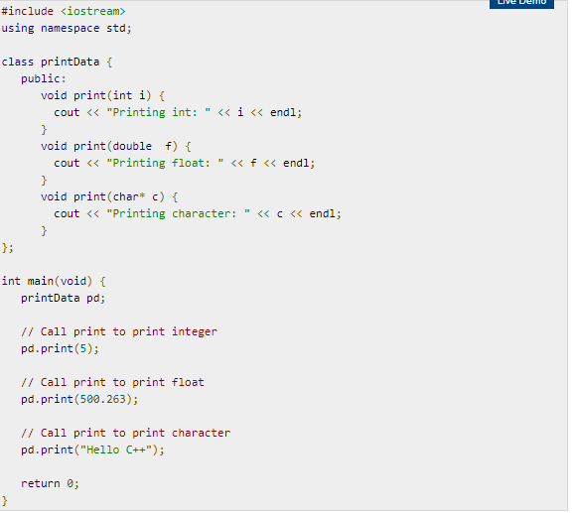

Slide 43
friend Function in C++
If a function is defined as a friend function then, the private and protected data of a class can be accessed using the function.
The complier knows a given function is a friend function by the use of the keyword friend.
For accessing the data, the declaration of a friend function should be made inside the body of the class
(can be anywhere inside class either in private or public section) starting with keyword friend.

Slide 44
Declaration of friend function in C++
class class_name {
... .. ...
friend return_type function_name(argument/s);
... .. ...
}

Slide 45
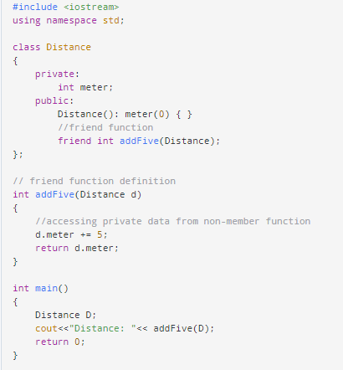

Slide 46
INTERACTION DIAGRAM

Slide 47
Definition:
Interaction Shows an Arc, consisting of a set of objects and their relationships, including the messages that may be dispatched among them.
Interaction diagram address the dynamic view of the system.

Slide 48
Purpose of Interaction Diagram:
The purpose of interaction diagram is :
Interaction diagrams are used to observe the dynamic behavior of a system.
Interaction diagram visualizes the communication and sequence of message passing in the system.
Interaction diagram represents the structural aspects of various objects in the system.
Interaction diagram represents the ordered sequence of interactions within a system.
Interaction diagram provides the means of visualizing the real time data via UML.

Slide 49
This interactive behavior is represented in UML by two diagrams known as
Sequence diagram
Collaboration diagram.
Sequence diagram emphasizes on time sequence of messages from one object to another.
Collaboration diagram emphasizes on the structural organization of the objects that send and receive messages.

Slide 50
How to Draw an Interaction Diagram?
The purpose of interaction diagrams is to capture the dynamic aspect of a system. So to capture the dynamic aspect, we need to understand what a dynamic aspect is and how it is visualized. Dynamic aspect can be defined as the snapshot of the running system at a particular moment.
Following things are to be identified clearly before drawing the interaction diagram
Objects taking part in the interaction.
Message flows among the objects.
The sequence in which the messages are flowing.
Object organization.

Slide 51
Sequence Diagram:
A sequence diagram simply depicts interaction between objects in a sequential order i.e. the order in which these interactions take place.

Slide 52
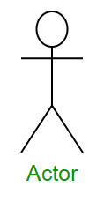
Sequence Diagram Notations
1. Actors :
An actor in a UML diagram represents a type of role where it interacts with the system and its objects.

Slide 53
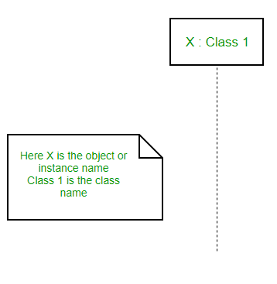
2.Lifelines :
A lifeline is a named element which depicts an individual participant in a sequence diagram. So basically each instance in a sequence diagram is represented by a lifeline.
Lifeline elements are located at the top in a sequence diagram.
lifeline follows the following format :
Instance Name : Class Name

Slide 54
3.Messages :
Communication between objects is depicted using messages. The messages appear in a sequential order on the lifeline.
We represent messages using arrows. Lifelines and messages form the core of a sequence diagram.

Slide 55
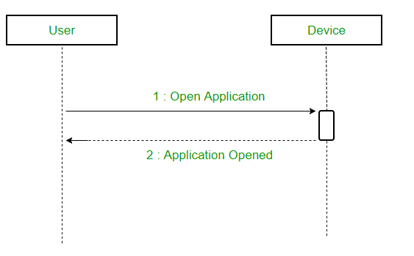
(i)Synchronous messages
A synchronous message waits for a reply before the interaction can move forward.
The sender waits until the receiver has completed the processing of the message.
The caller continues only when it knows that the receiver has processed the previous message i.e. it receives a reply message.
A large number of calls in object oriented programming are synchronous. We use a solid arrow head to represent a synchronous message.

Slide 56
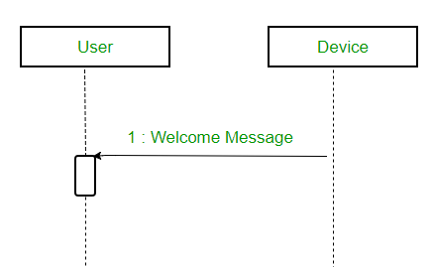
(ii)Asynchronous Messages
An asynchronous message does not wait for a reply from the receiver.
The interaction moves forward irrespective of the receiver processing the previous message or not.
We use a lined arrow head to represent an asynchronous message.

Slide 57
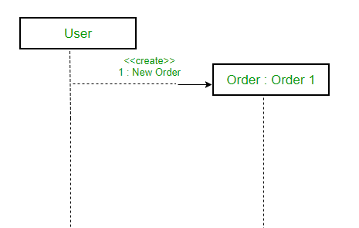
(iii) Create message
We use a Create message to instantiate a new object in the sequence diagram.
It is represented with a dotted arrow and create word labeled on it to specify that it is the create Message symbol. For example :
The creation of a new order on a e-commerce website would require a new object of Order class to be created.

Slide 58
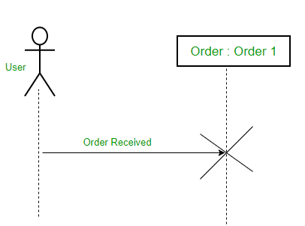
(iv) Delete Message
We use a Delete Message to delete an object.
It destroys the occurrence of the object in the system.
It is represented by an arrow terminating with a x. For example – In the scenario below when the order is received by the user, the object of order class can be destroyed

Slide 59
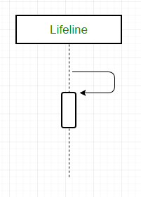
(v) Self Message
A message an object sends to itself, usually shown as a U shaped arrow pointing back to itself.

Slide 60

(vi) Reply Message
Reply messages are used to show the message being sent from the receiver to the sender.
We represent a return/reply message using an open arrowhead with a dotted line.
The interaction moves forward only when a reply message is sent by the receiver.

Slide 61
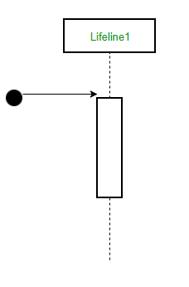
(vii) Found Message
A Found message is used to represent a scenario where an unknown source sends the message.
It is represented using an arrow directed towards a lifeline from an end point.

Slide 62
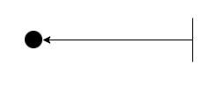
(viii) Lost Message
A Lost message is used to represent a scenario where the recipient is not known to the system.
It is represented using an arrow directed towards an end point from a lifeline.
For example:

Slide 63
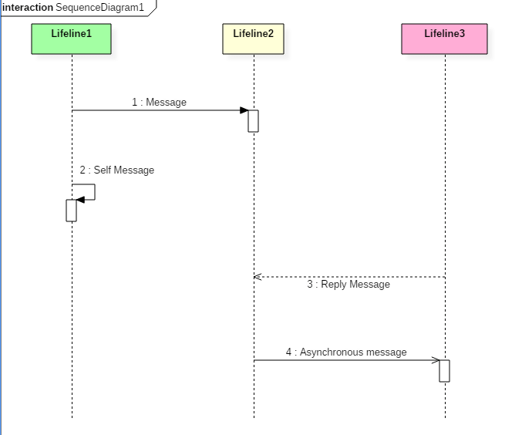
Sample example:
The above sequence diagram contains lifeline notations and notation of various messages used in a sequence diagram such as a create, reply, asynchronous message, etc.

Slide 64
Example:
The ordered sequence of events in a given sequence diagram is as follows:
Place an order.
Pay money to the cash counter.
Order Confirmation.
Order preparation.
Order serving.

Slide 65
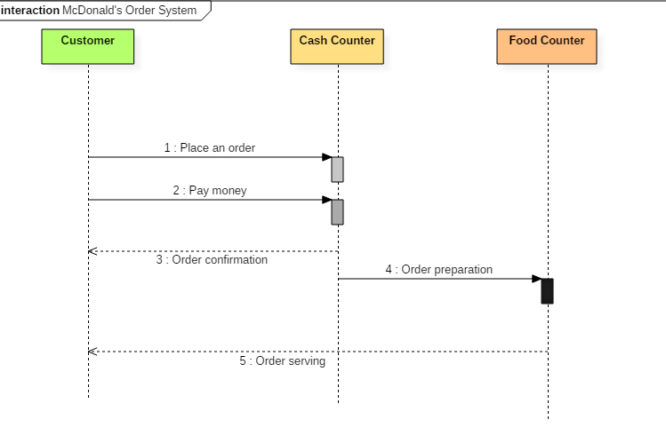
Sequence diagram example(1)
The following sequence diagram example represents McDonald's ordering system:

Slide 66
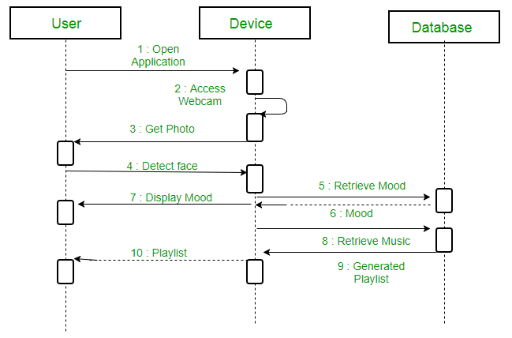
Example(2)
A sequence diagram for an emotion based music player

Slide 67
Firstly the application is opened by the user.
The device then gets access to the web cam.
The webcam captures the image of the user.
The device uses algorithms to detect the face and predict the mood.
It then requests database for dictionary of possible moods.
The mood is retrieved from the database.
The mood is displayed to the user.
The music is requested from the database.
The playlist is generated and finally shown to the user.

Slide 68
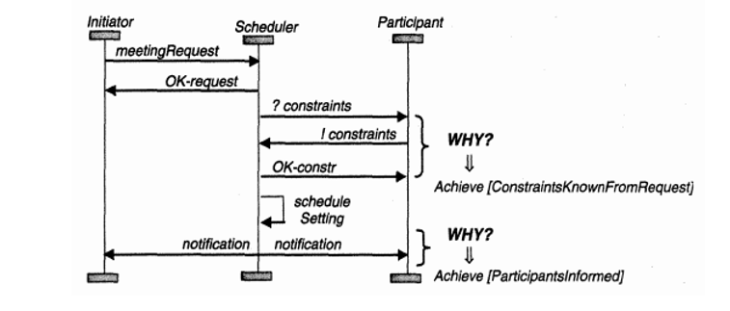

Slide 69
Benefits of a Sequence Diagram
Sequence diagrams are used to explore any real application or a system.
Sequence diagrams are used to represent message flow from one object to another object.
Sequence diagrams are easier to maintain.
Sequence diagrams are easier to generate.
Sequence diagrams can be easily updated according to the changes within a system.
Sequence diagram allows reverse as well as forward engineering.

Slide 70
Drawbacks of a sequence diagram
Sequence diagrams can become complex when too many lifelines are involved in the system.
If the order of message sequence is changed, then incorrect results are produced.
Each sequence needs to be represented using different message notation, which can be a little complex.
The type of message decides the type of sequence inside the diagram.

Slide 71
Draw Sequence Diagram of an Online Exam System with following lifelines admin,examiner,student,test,response, result

Slide 72
Collaboration diagram
COLLABORATION DIAGRAM depicts the relationships and interactions among software objects. They are used to understand the object architecture within a system rather than the flow of a message as in a sequence diagram. They are also known as “Communication Diagrams.”
In the collaboration diagram, the method call sequence is indicated by some numbering technique. The number indicates how the methods are called one after another.

Slide 73
Benefits of Collaboration Diagram
It is also called as a communication diagram.
It emphasizes the structural aspects of an interaction diagram - how lifeline connects.
Its syntax is similar to that of sequence diagram except that lifeline don't have tails.
Messages passed over sequencing is indicated by numbering each message hierarchically.
Compared to the sequence diagram communication diagram is semantically weak.
Object diagrams are special case of communication diagram.
It allows you to focus on the elements rather than focusing on the message flow as described in the sequence diagram.
Sequence diagrams can be easily converted into a collaboration diagram as collaboration diagrams are not very expressive.

Slide 74
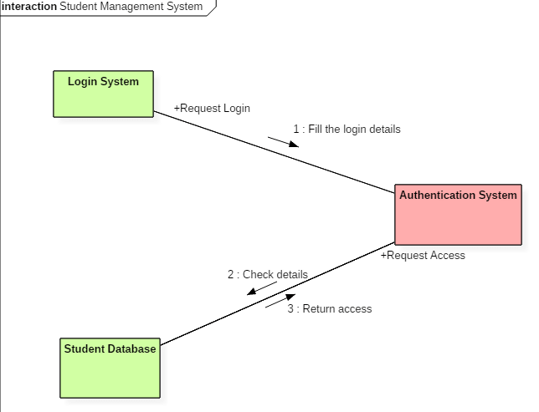
Example
Following diagram represents the sequencing over student management system:

Slide 75
The above collaboration diagram represents a student information management system. The flow of communication in the above diagram is given by,
A student requests a login through the login system.
An authentication mechanism of software checks the request.
If a student entry exists in the database, then the access is allowed; otherwise, an error is returned.

Slide 76
Inheritance in C++
The capability of a class to derive properties and characteristics from another class is called Inheritance. Inheritance is one of the most important featureofObjectOrientedProgramming.
Sub Class: The class that inherits properties from another class is called Sub class or Derived Class.
Super Class: The class whose properties are inherited by sub class is called Base Class or Super class.

Slide 77
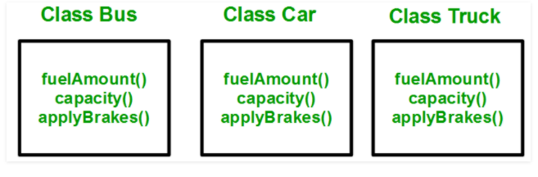
Why and when to use inheritance?
Consider a group of vehicles. You need to create classes for Bus, Car and Truck. The methods fuelAmount(), capacity(), applyBrakes() will be same for all of the three classes. If we create these classes avoiding inheritance then we have to write all of these functions in each of the three classes as shown in below figure:

Slide 78
Drawbacks
You can clearly see that above process results in duplication of same code 3 times.
This increases the chances of error and data redundancy

Slide 79
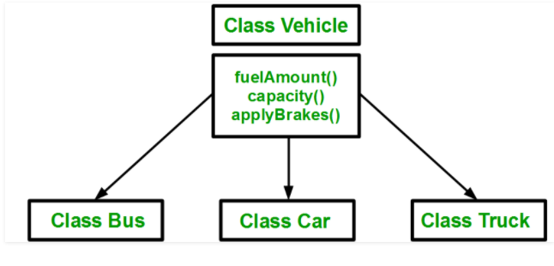
Why inheritance
To avoid this type of situation, inheritance is used. If we create a class Vehicle and write these three functions in it and inherit the rest of the classes from the vehicle class, then we can simply avoid the duplication of data and increase re-usability. Look at the below diagram in which the three classes are inherited from vehicle class:

Slide 80
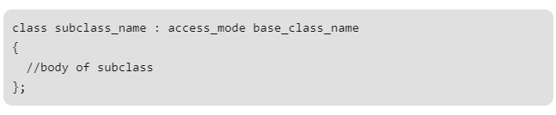
syntax.
For creating a sub-class which is inherited from the base class we have to follow the below syntax.

Slide 81
Modes of Inheritance
Public mode: If we derive a sub class from a public base class. Then the public member of the base class will become public in the derived class and protected members of the base class will become protected in derived class.
Protected mode: If we derive a sub class from a Protected base class. Then both public member and protected members of the base class will become protected in derived class.
Private mode: If we derive a sub class from a Private base class. Then both public member and protected members of the base class will become Private in derived class.

Slide 82
Simple inheritance program
// C++ program to demonstrate implementation // of Inheritance #include <bits/stdc++.h> using namespace std; //Base class class Parent { public: int id_p; }; // Sub class inheriting from Base Class(Parent) class Child : public Parent { public: int id_c; }; //main function int main() { Child obj1; // An object of class child has all data members // and member functions of class parent obj1.id_c = 7; obj1.id_p = 91; cout << "Child id is " << obj1.id_c << endl; cout << "Parent id is " << obj1.id_p << endl; return 0; }

Slide 83
Cont.
Put into a diagram, the relationship between peachs, Guavas, and fruit might look something like this:
Fruit
Peach
Guava

Slide 84
Types of Inheritance
Single Inheritance
Multiple Inheritance
Multilevel Inheritance
Hierarchical Inheritance
Hybrid Inheritance

Slide 85
Single Inheritance
In single inheritance, a class derives from one base class only. This means that there is only one subclass that is derived from one superclass.
Syntax:
Class A
Class B

Slide 86
Multiple Inheritance
A class can inherit properties from more than one class which is known as multiple inheritances.
Syntax:
Class B
Class C
Class A

Slide 87
Multilevel Inheritance
A class can be derived from another derived class which is known as multilevel inheritance.
Class C
Class B
Class A

Slide 88
Hierarchical Inheritance
In this type of inheritance, one parent class has more than one child class
Class A
Class B
Class C
Class b1
Class b2
Class c1
Class c2

Slide 89
Hybrid Inheritance
There could be situations where we need to apply two or more types of inheritance to design one inheritance called hybrid inheritance.
Class C
Class B
Class D
Class A

Slide 90
Unit 3

Slide 91
C++ Single Inheritance
If a single class is derived from one base class then it is called single inheritance. In C++ single inheritance base and derived class exhibit one to one relation.

Slide 92
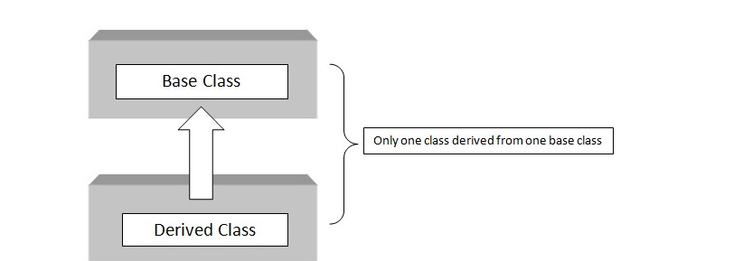
BLOCK DIAGRAM

Slide 93
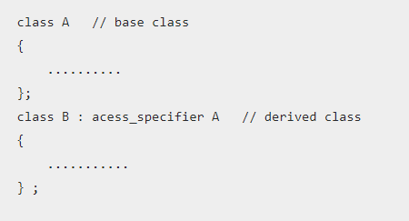
C++ Programming Single Inheritance Syntax

Slide 94
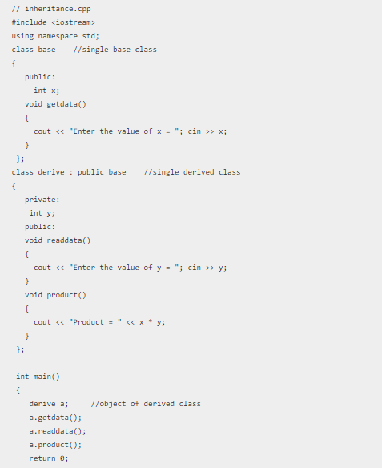
C++ Single Inheritance Example

Slide 95
C++ Multiple Inheritance
If a class is derived from two or more base classes then it is called multiple inheritance. In C++ multiple inheritance a derived class has more than one base class.

Slide 96
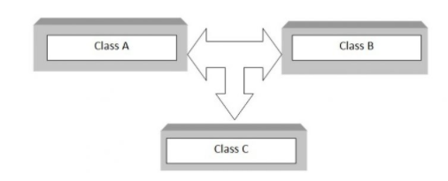
C++ Multiple Inheritance Block Diagram

Slide 97
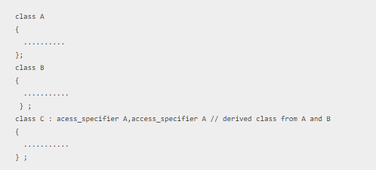
C++ Multiple Inheritance Syntax

Slide 98
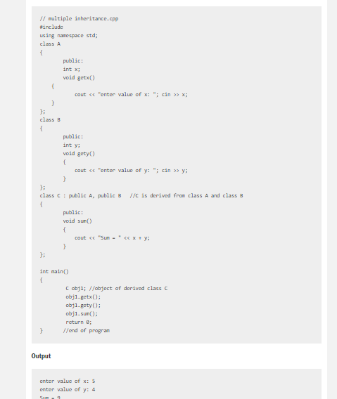

Slide 99
How does multiple inheritance differ from multilevel inheritance?
Though but multiple and multilevel sounds like same but they differ hugely in meaning.
To put it in simple words, in multilevel inheritance, a class is derived from a class which is also derived from another base class. And these levels of inheritance can be extended. On the contrary, in multiple inheritance, a class is derived from two different base classes.
For example
Multilevel inheritance : Inheritance of characters by a child from father and father inheriting characters from his father (grandfather)
Multiple inheritance : Inheritance of characters by a child from mother and father

Slide 100
C++ Multilevel Inheritance
If a class is derived from another derived class then it is called multilevel inheritance. So in C++ multilevel inheritance, a class has more than one parent class.

Slide 101
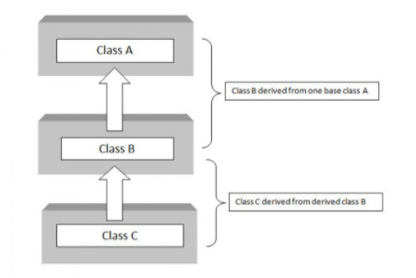
C++ Multilevel Inheritance Block Diagram

Slide 102
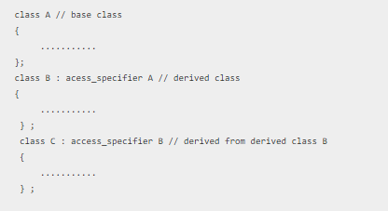
C++ Programming Multilevel Inheritance Syntax

Slide 103
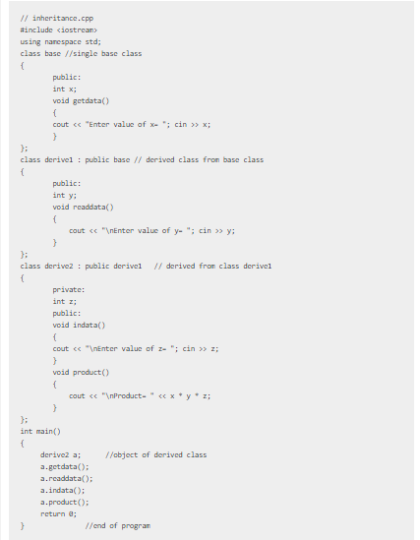

Slide 104
C++ Hierarchical Inheritance
When several classes are derived from common base class it is called hierarchical inheritance.
In C++ hierarchical inheritance, the feature of the base class is inherited onto more than one sub-class.
For example, a car is a common class from which Audi, Ferrari, Maruti etc can be derived.

Slide 105
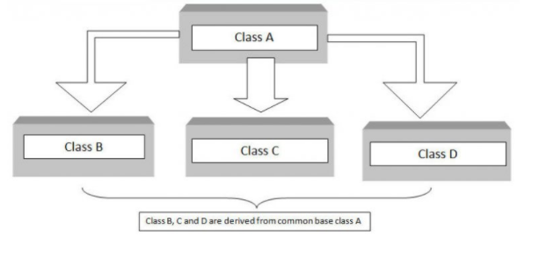
C++ Hierarchical Inheritance Block Diagram

Slide 106
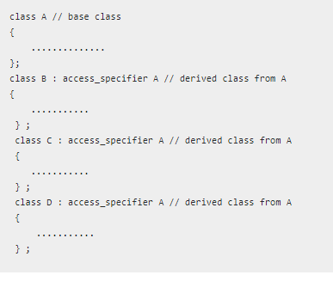
C++ Hierarchical Inheritance Syntax

Slide 107
C++ Hybrid Inheritance
The inheritance in which the derivation of a class involves more than one form of any inheritance is called hybrid inheritance. Basically C++ hybrid inheritance is combination of two or more types of inheritance. It can also be called multi path inheritance.

Slide 108
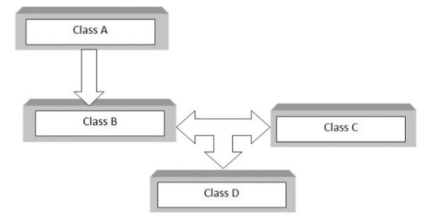
C++ Hybrid Inheritance Block Diagram

Slide 109
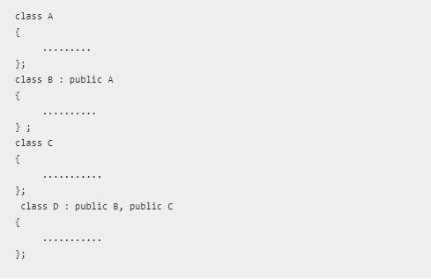
C++ Hybrid Inheritance Syntax

